Slide 1


I have channels but no water, waves but no ocean. What am I?
I’m always updating but never changing my mind. What am I?
I’m a room full of racks but no clothing in sight. What am I?
Notes:
Wifi
Software
Server Room

Slide 2

Learning Objectives
Explain the features and uses of different types of operating systems
Explain the features and uses of common utility software
Explain the features and uses of common application software
Identify which type of software is needed in a given situation

Slide 3

Software

Slide 4

Operating Systems

Slide 5

What software do you use most often on your phone on computer, and what do you use it for?
Notes:
PSU
GPU/Graphics card
SSD
Washing machine board
Blood fridge smart sensor

Slide 6

Batch OS
Non-Interactive
High Volume
Scheduled
Examples: Overnight backups, payroll software, report generators

Slide 7

Multitasking OS
Concurrent tasks
Time-slicing
Interrupts
Examples: Windows, Mac, Linux
Notes:
A time slice is a short, defined interval during which a process can be executed in a multitasking operating system. Think of it as a tiny chunk of CPU time given to each running process.

Slide 8

Real Time OS
Instant response
Monitoring
Transaction processing
Examples: Air traffic control system, pace maker
Notes:
A real-time operating system (RTOS) is a specialized operating system designed to handle time-critical tasks with precision and efficiency.
In an RTOS-based air traffic control system, multiple sensors and radars work to gather information about aircraft positions, speeds, altitudes, and flight plans. The RTOS processes this data in real time to monitor airspace congestion, detect potential conflicts or emergencies, and provide instructions to pilots.
(https://www.spiceworks.com/tech/hardware/articles/what-is-rtos/)

Slide 9

Network OS
Resource Sharing
User management
Comms
Examples: Windows Server, Linux
Notes:
A real-time operating system (RTOS) is a specialized operating system designed to handle time-critical tasks with precision and efficiency.
In an RTOS-based air traffic control system, multiple sensors and radars work to gather information about aircraft positions, speeds, altitudes, and flight plans. The RTOS processes this data in real time to monitor airspace congestion, detect potential conflicts or emergencies, and provide instructions to pilots.
(https://www.spiceworks.com/tech/hardware/articles/what-is-rtos/)

Slide 10

Mobile OS
Lower processing
Battery efficiency
Examples: Smartphones, Tablets, some iOT
Notes:
A real-time operating system (RTOS) is a specialized operating system designed to handle time-critical tasks with precision and efficiency.
In an RTOS-based air traffic control system, multiple sensors and radars work to gather information about aircraft positions, speeds, altitudes, and flight plans. The RTOS processes this data in real time to monitor airspace congestion, detect potential conflicts or emergencies, and provide instructions to pilots.
(https://www.spiceworks.com/tech/hardware/articles/what-is-rtos/)

Slide 11
Pairs Task
Choose one of the scenarios on the next slide and choose an OS type. Create a short written pitch including:
-What your OS does well
-Why it’s the best fit for the job
-Why other OS’s wouldn’t be suitable
Notes:
A real-time operating system (RTOS) is a specialized operating system designed to handle time-critical tasks with precision and efficiency.
In an RTOS-based air traffic control system, multiple sensors and radars work to gather information about aircraft positions, speeds, altitudes, and flight plans. The RTOS processes this data in real time to monitor airspace congestion, detect potential conflicts or emergencies, and provide instructions to pilots.
(https://www.spiceworks.com/tech/hardware/articles/what-is-rtos/)

Slide 12
Pairs Task
A large bank needs an OS that can process thousands of customer bank statements overnight
A global business wants an OS that allows 500 employees to share files, printers, and logins securely
A factory runs automated machines that must respond to sensor input in real time
Notes:
A real-time operating system (RTOS) is a specialized operating system designed to handle time-critical tasks with precision and efficiency.
In an RTOS-based air traffic control system, multiple sensors and radars work to gather information about aircraft positions, speeds, altitudes, and flight plans. The RTOS processes this data in real time to monitor airspace congestion, detect potential conflicts or emergencies, and provide instructions to pilots.
(https://www.spiceworks.com/tech/hardware/articles/what-is-rtos/)

Slide 13
Discussion
Choose one of the scenarios on the next slide and choose an OS type. Create a short written pitch including:
-What your OS does well
-Why it’s the best fit for the job
-Why other OS’s wouldn’t be suitable
Notes:
A real-time operating system (RTOS) is a specialized operating system designed to handle time-critical tasks with precision and efficiency.
In an RTOS-based air traffic control system, multiple sensors and radars work to gather information about aircraft positions, speeds, altitudes, and flight plans. The RTOS processes this data in real time to monitor airspace congestion, detect potential conflicts or emergencies, and provide instructions to pilots.
(https://www.spiceworks.com/tech/hardware/articles/what-is-rtos/)

Slide 14

Utilities
Notes:
File management
Defragmenters
File compression
Package managers
Protection software
Backup software

Slide 15

I’ve got some problems...
My hard drive is full of pictures of my cats
My files are too big but I can’t delete them
I need to back all my stuff up because my PC fried itself a few months ago and I lost everything
Notes:
Defragmenters (takes scattered pieces of hardrives and merges them into blocks, makes them faster)
File compression
Backup software

Slide 16
I’ve got some problems...
I need to automatically deploy some software to another PC in my house
I download what I think is software but it does weird things to my PC
I need to organise some of my documents because they’re in 20 different places
Notes:
File management
Anti virus software
Package managers

Slide 17


Backup Software
Onsite vs Offsite
Full
Incremental
Differential
Notes:
Full = Full backup every day
Incremental backups only back up the data that has changed since the previous backup.
A differential backup starts with a full backup; subsequent backups only contain data that has changed. The difference between incremental vs. differential backups is that, while an incremental backup only includes the data that has changed since the previous backup, a differential backup contains all the data that has changed since the last full backup.

Slide 18

Applications
Notes:
File management
Defragmenters
File compression
Package managers
Protection software
Backup software

Slide 19
Applications
Create and edit text docs
Word processor
Numerical data analysis
Spreadsheet
Organises and stores structured data
Database
Communication via messages
Email
Plan/track tasks
Project Management

Slide 20
A student is writing a CV that includes headings and bullet points
A manager needs to send quick updates to a team working remotely.
A project leader wants to track task deadlines and assign responsibilities
Notes:
File management
Defragmenters
File compression
Package managers
Protection software
Backup software

Slide 21
A small shop owner wants to calculate weekly profits and display them in a chart.
A college needs to store contact information and attendance records for 500 students.
Notes:
F

Slide 22

A charity wants to write thank-you letters to donors but also keep track of who has donated.
Which combination of applications would work best?
What limitations does email have, and how could project management software improve collaboration?
Notes:
File management
Defragmenters
File compression
Package managers
Protection software
Backup software

Slide 23
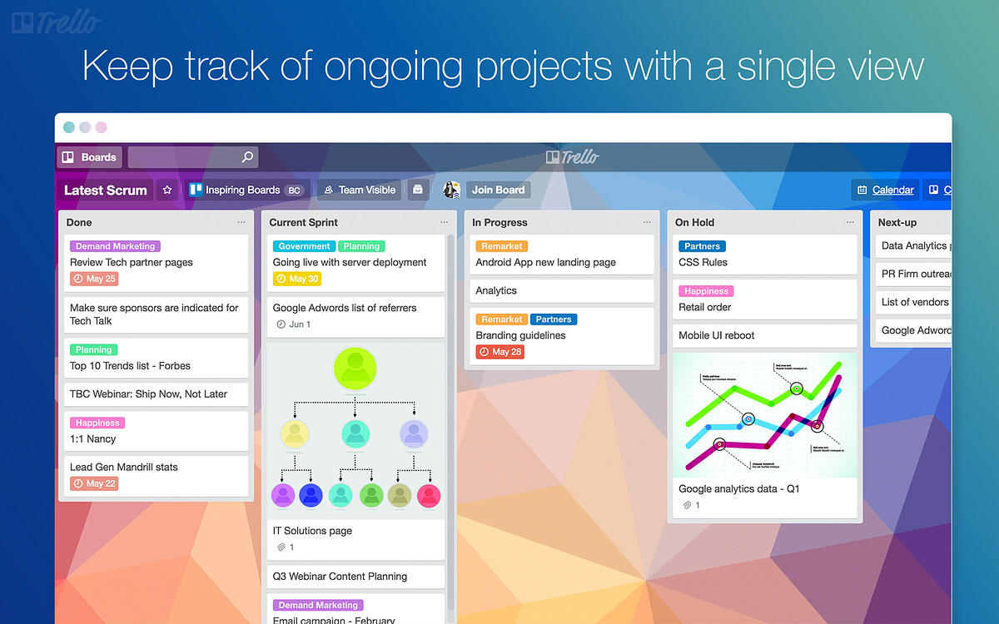
Notes:
File management
Defragmenters
File compression
Package managers
Protection software
Backup software

Slide 24
Individual Task
Go to the Digital Environments section in your Onenote. In here you will see a Server Research Task. Research the various server types listed and fill out the table provided. Ensure you include sources used
Notes:
A real-time operating system (RTOS) is a specialized operating system designed to handle time-critical tasks with precision and efficiency.
In an RTOS-based air traffic control system, multiple sensors and radars work to gather information about aircraft positions, speeds, altitudes, and flight plans. The RTOS processes this data in real time to monitor airspace congestion, detect potential conflicts or emergencies, and provide instructions to pilots.
(https://www.spiceworks.com/tech/hardware/articles/what-is-rtos/)

Slide 25
Discuss
Go to the Digital Environments section in your Onenote. In here you will see a Server Research Task. Research the various server types listed and fill out the table provided. Ensure you include sources used
Notes:
A real-time operating system (RTOS) is a specialized operating system designed to handle time-critical tasks with precision and efficiency.
In an RTOS-based air traffic control system, multiple sensors and radars work to gather information about aircraft positions, speeds, altitudes, and flight plans. The RTOS processes this data in real time to monitor airspace congestion, detect potential conflicts or emergencies, and provide instructions to pilots.
(https://www.spiceworks.com/tech/hardware/articles/what-is-rtos/)

Slide 26

RAID Recap

Slide 28

-

Slide 29
Go to https://www.netacad.com/
Sign up to an account - I would recommend doing this under your own email

Slide 30
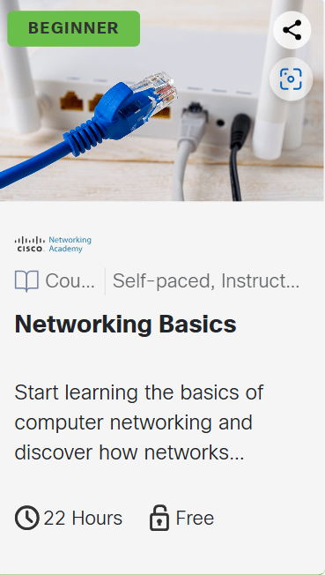
Start with module 1

Slide 31

Which type of software do you think is most important for a business and why?
What’s 1 question you have after today’s lesson?

